Slide 1

WELCOME
How to make money in Stock Market
Introduction
to
Stock Markets

Slide 2

Market
Products
Buyers
Sellers

Slide 3

Financial Products
Stocks / Equity

Slide 4

Stock Market are also known as Stock Exchange.
Total 23 stock exchange
21 Regional Stock Exchange
2 National Stock Exchange

Slide 5
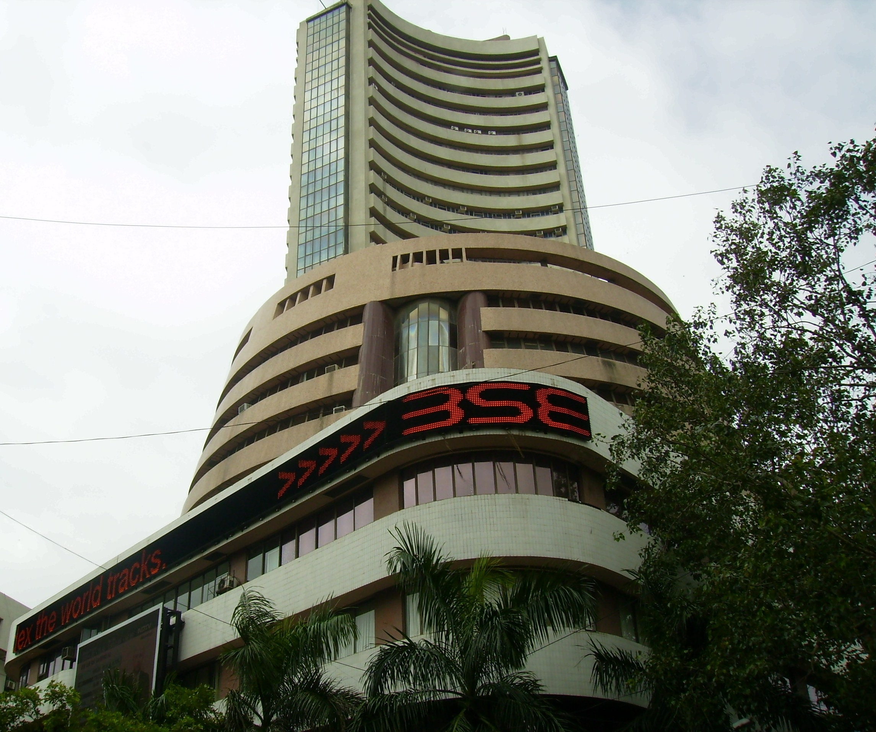
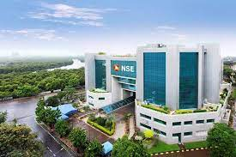
2 National Stock Exchange
Bombay Stock
Exchange (BSE)
National Stock
Exchange (NSE)
India and Asia’s first Stock Exchange
1875
Biggest Stock Exchange of India
1992

Slide 6

How to make
MONEY?
Study!!!

Slide 7

Technical
Analysis
Fundamental
Analysis

Slide 8
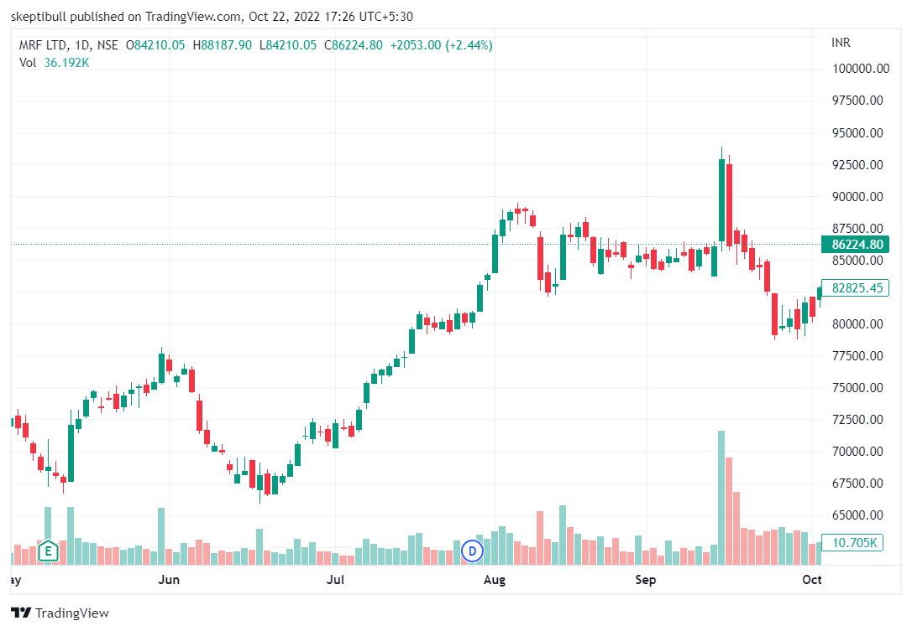
Technical
Analysis
Chart
Analysis
=
Candlesticks
Price Patterns
Moving Average
Price
Volume

Slide 9
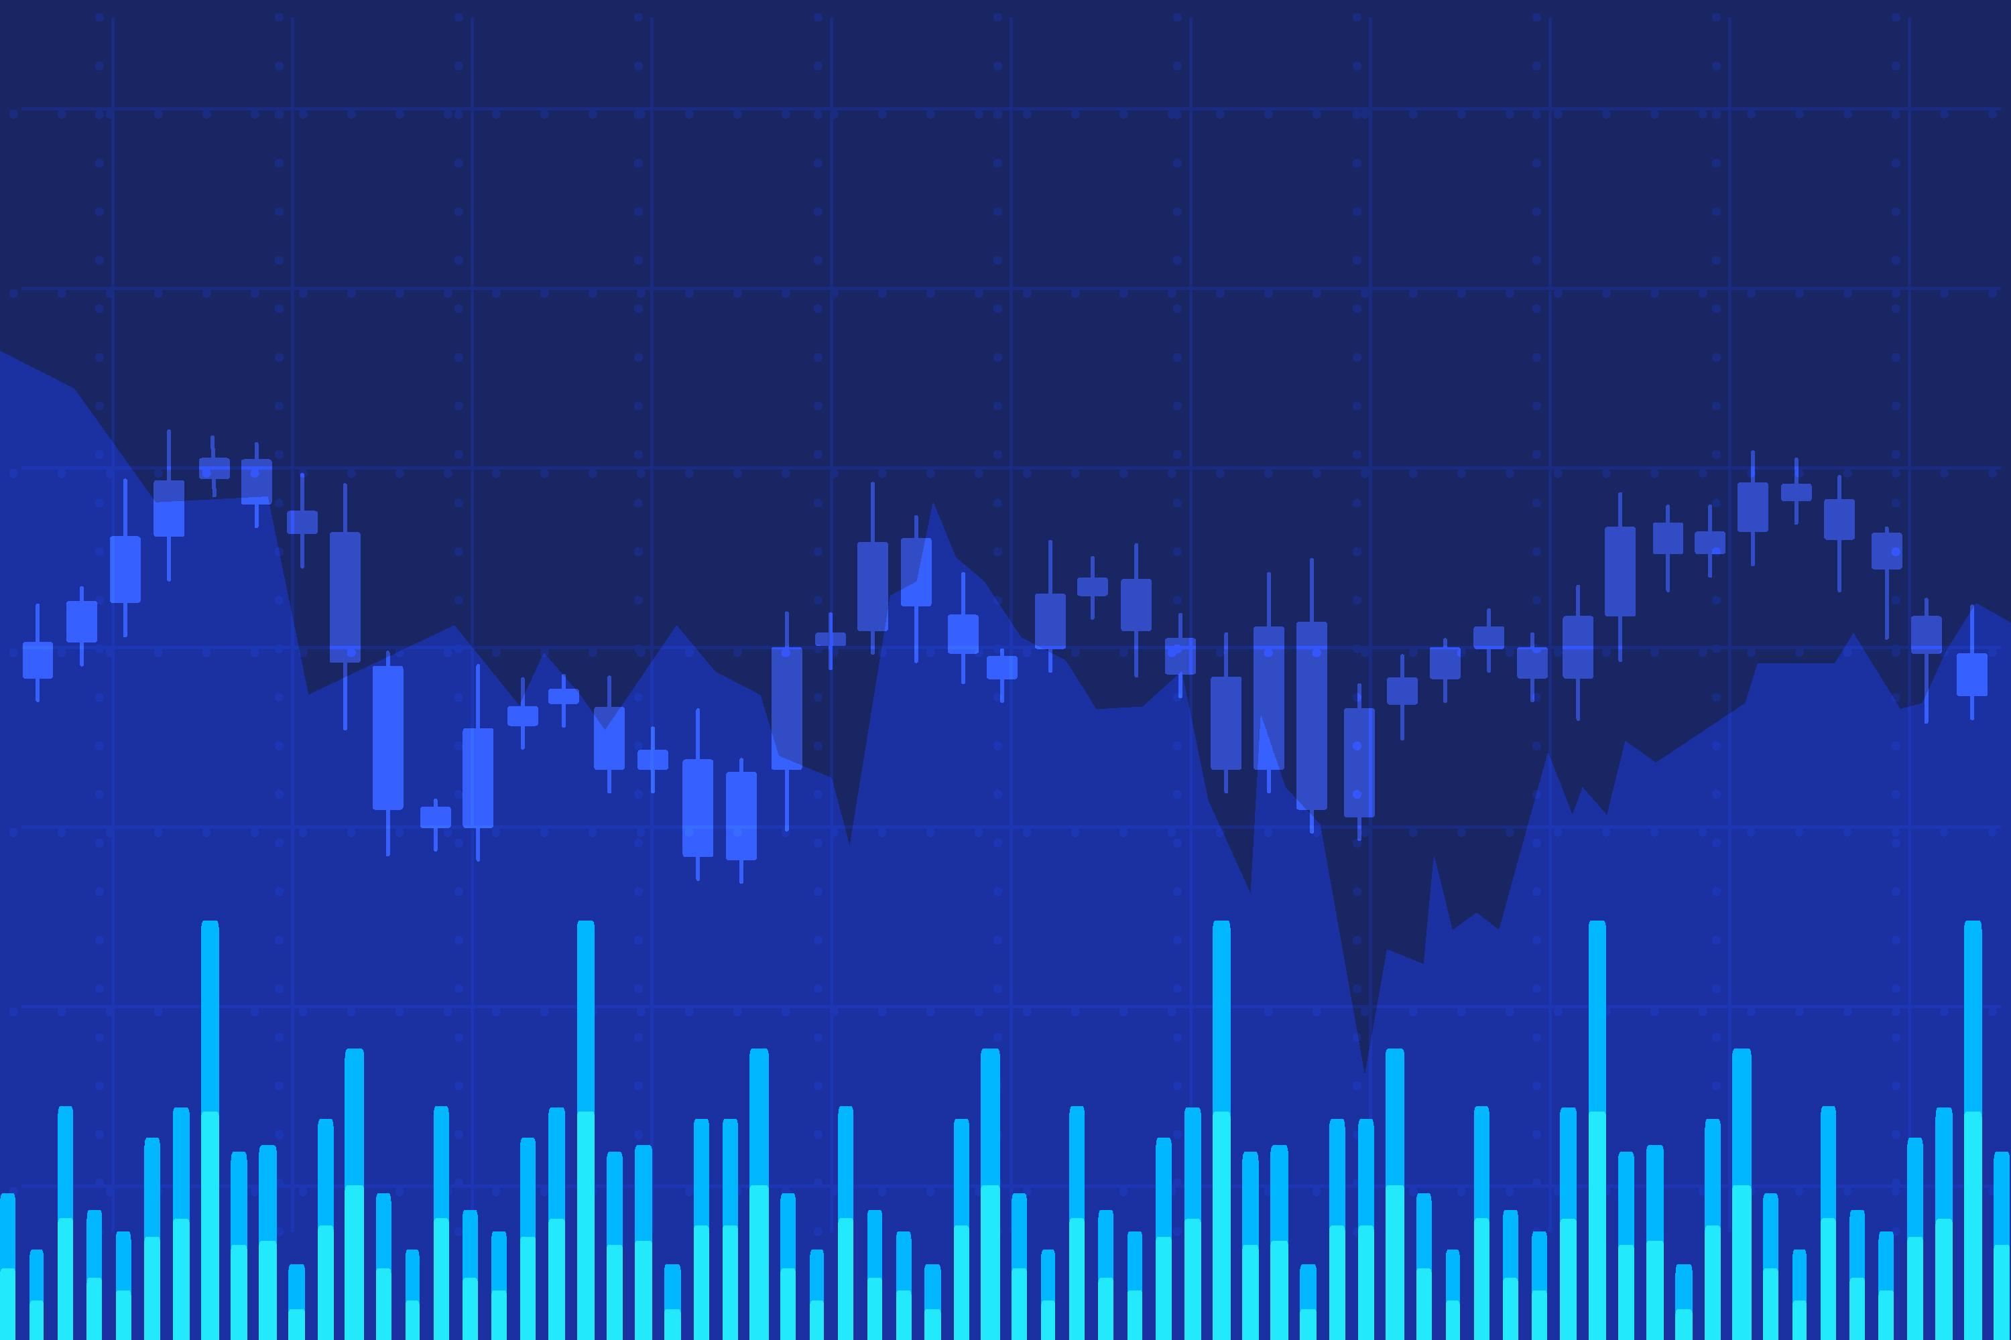
Technical Analysis
Trade
Equity
Futures
Options
Commodity
Forex
Crypto

Slide 10
Why Trade?
Quick Money
Make money in any Trend!

Slide 11

Do Traders make Money?

Slide 12

NO!!!
95% of retail traders are in Loss!!!

Slide 13

Institutions
Retail Trader
Big Players
Professionals
Experts

Slide 14
Retail Trader
FUEL
Is trading free?
Broker
NSE/BSE
GOVT
Marker Guru
Professionals

Slide 15

Will Retail Players never make
Money?

Slide 16



YES!
Investing
&
Compounding

Slide 17
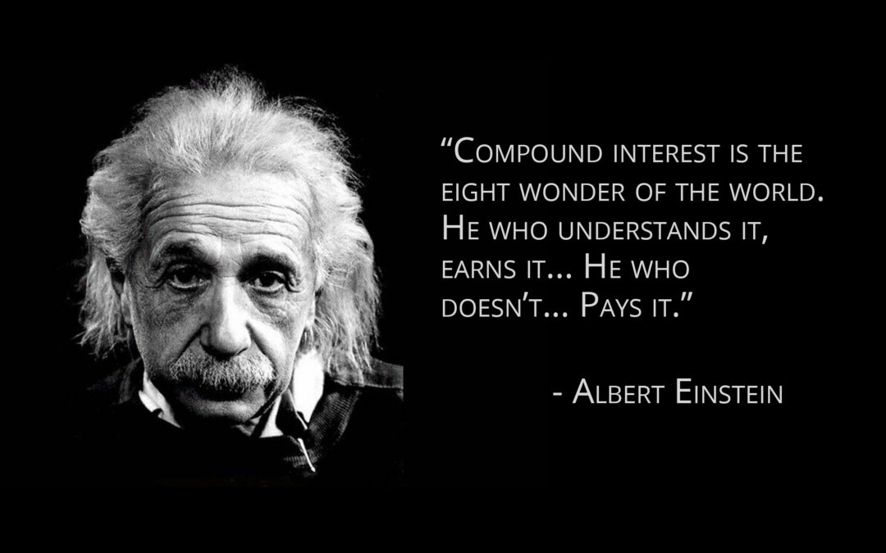

Slide 18

100
10%
= 110
110
10%
= 121
121
10%
= 133
Power of Compounding

Slide 19

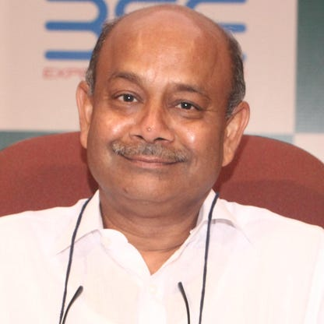
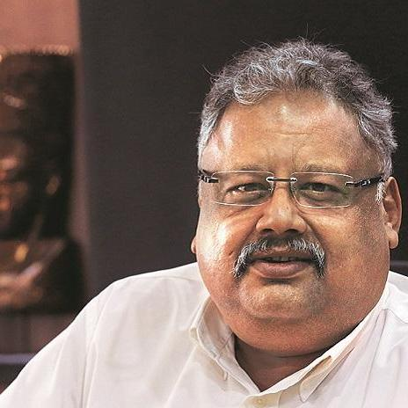
Warren Buffett
Radhakishan
Damani
Rakesh
Jhunjhunwala

Slide 20
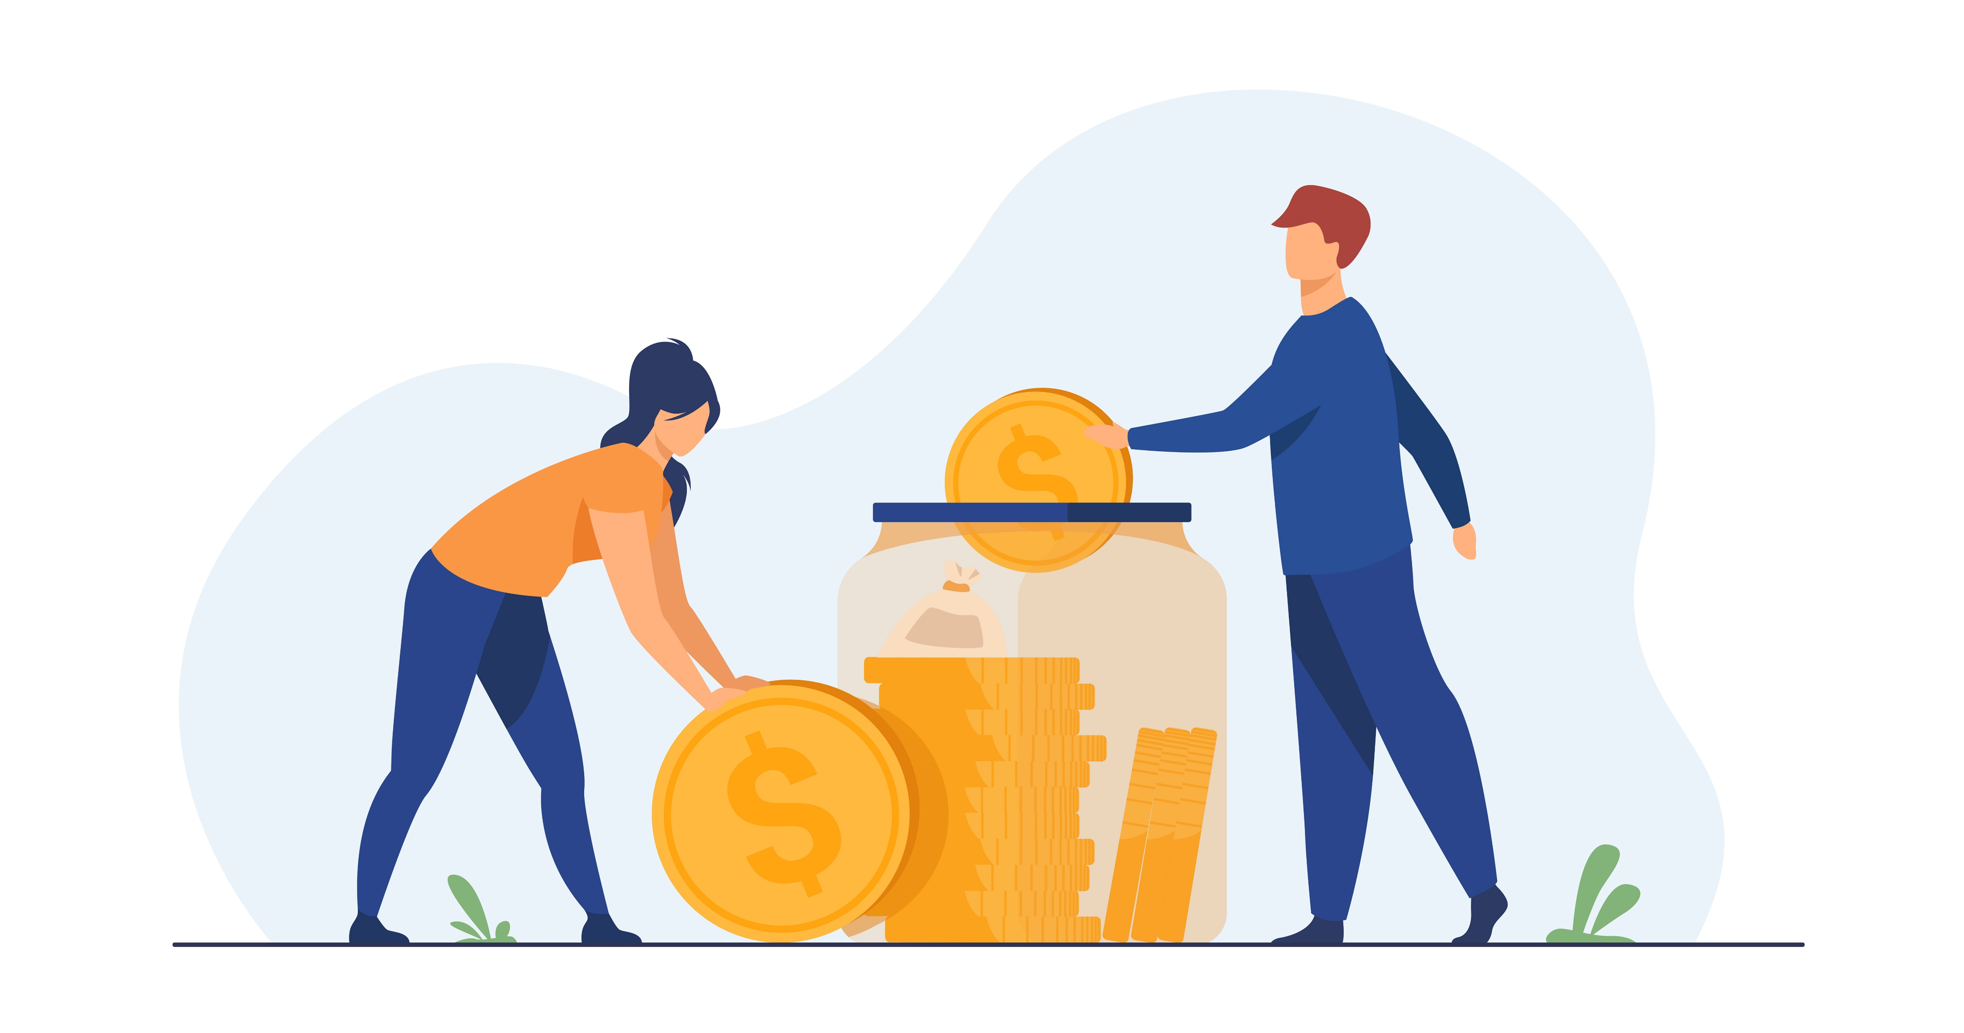
Purpose of entering Stock Market?
Wealth Creation
Financial
Goals
Car
House
Foreign Tour
Child Education
Savings

Slide 21

Investment
Fundamental Analysis
Quality of Stock
Future
Management
Books
Financial Ratios

Slide 22
How to select stocks?
Which stock to buy?
Which stock to avoid?
Which stocks will rally?
When to enter?
When to exit?
Capital Management?
Risk Management?

Slide 23
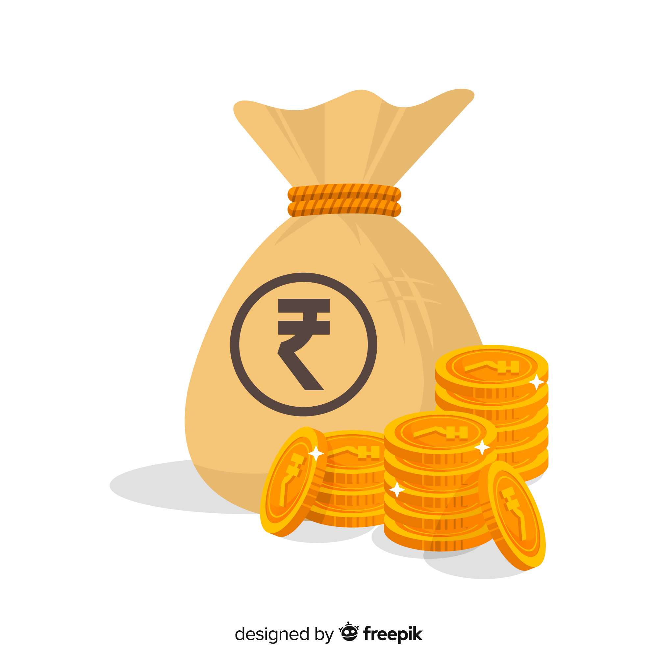
Shrewd Investor
Fundamental Analysis
Ratio Analysis
Stock Selection
Investment Strategies
Risk Management
Swing Trading
Sunday 10 AM
Duration 6-8 hours
Zoom or Skype

Slide 24


Shrewd Investor
Rs 10,000/-
Rs 999/-

Slide 25
#06283D
#F4F4F2
#FEB202
#FF8701
Buyers
Sellers

